Slide 1
Insta Smart
Online Shopping
-Vatsal Srivastava(2141076)

Slide 2
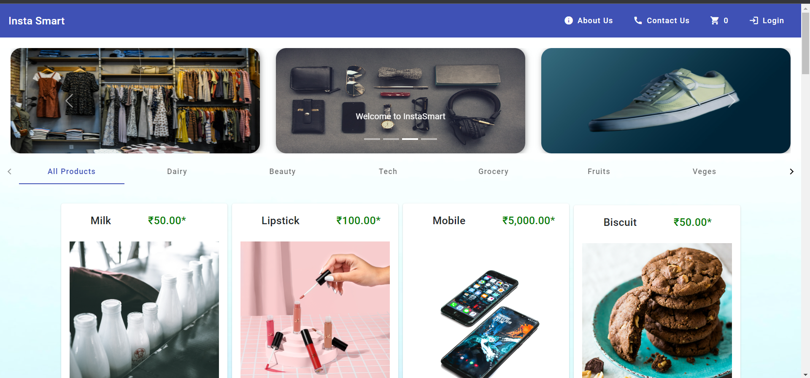
Landing Page

Slide 3
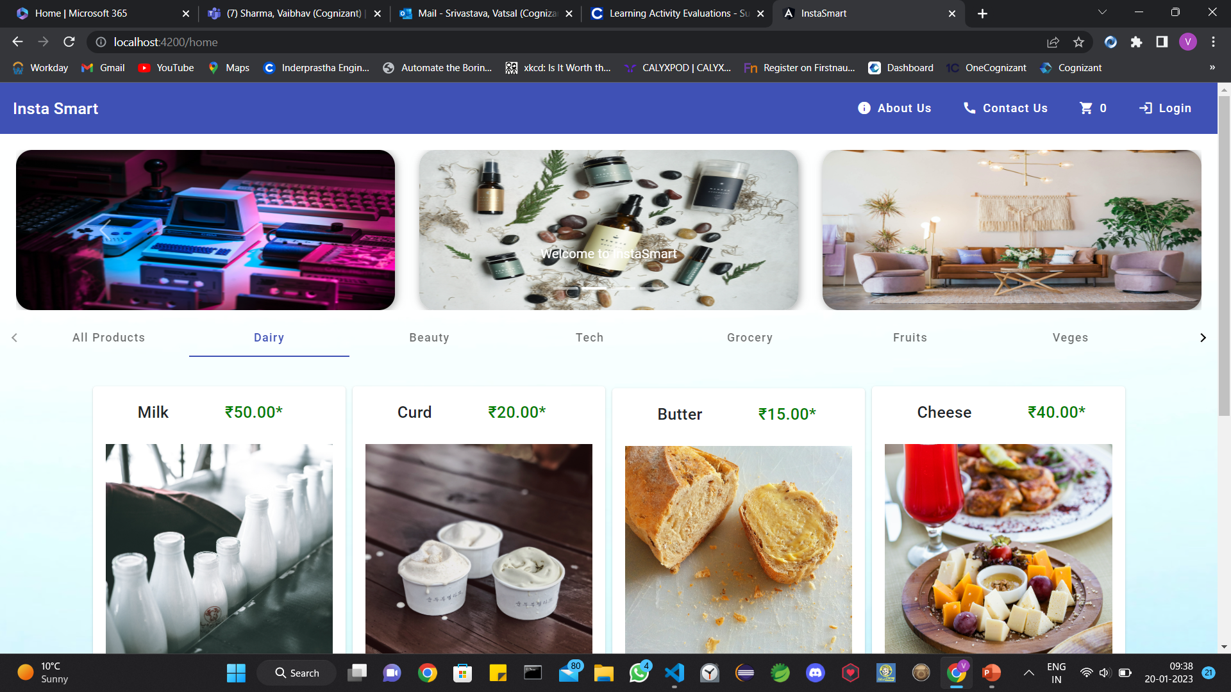
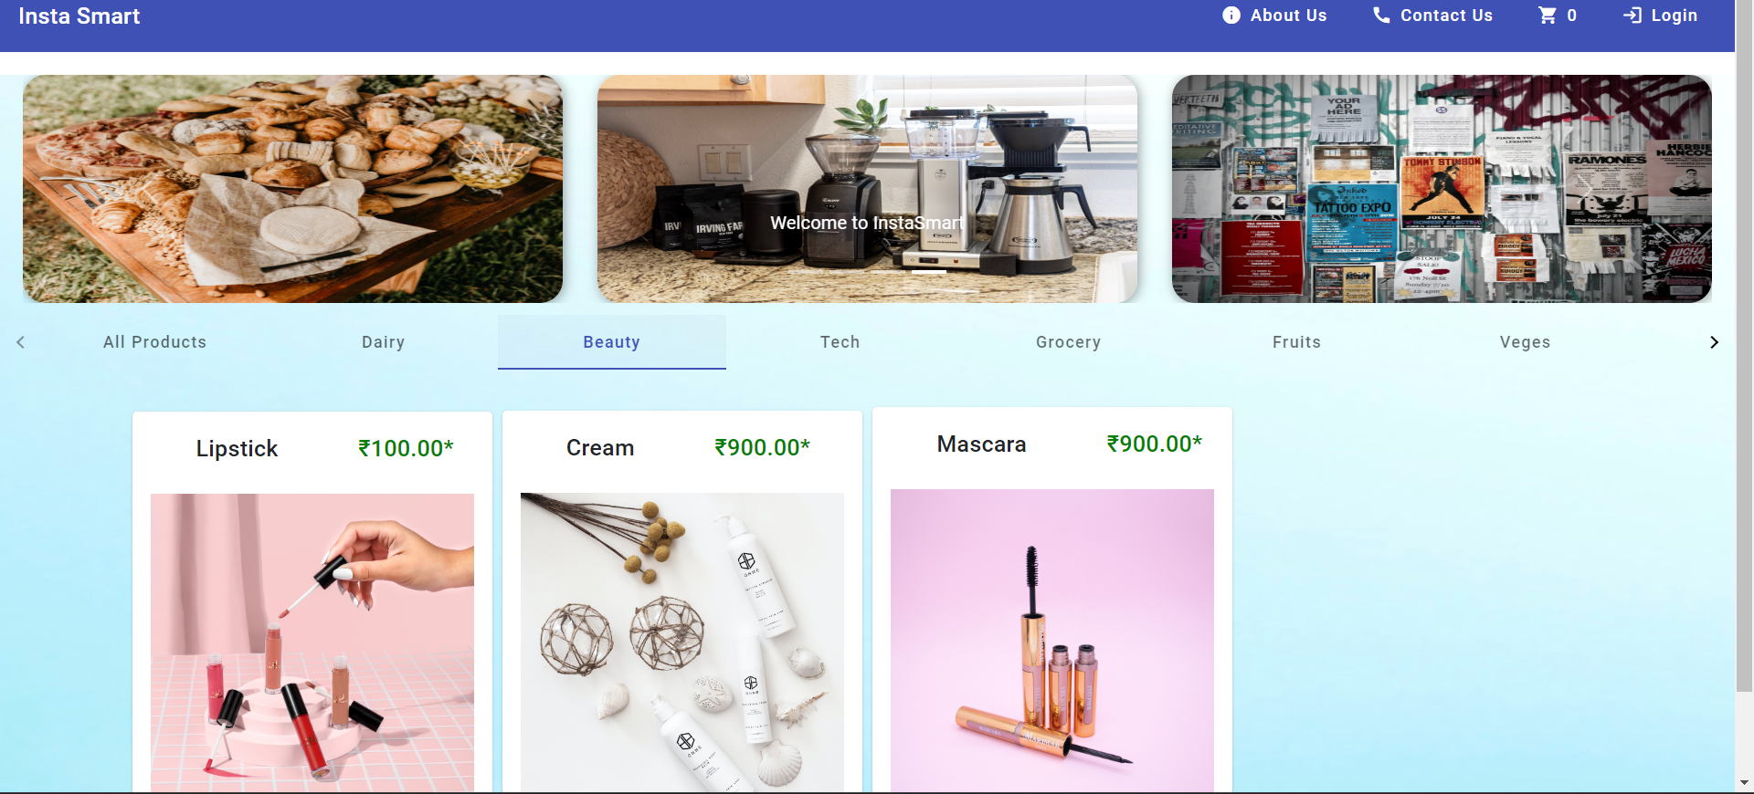
With Working Filter Tab & Carousel
Dairy Category
Beauty Category

Slide 4
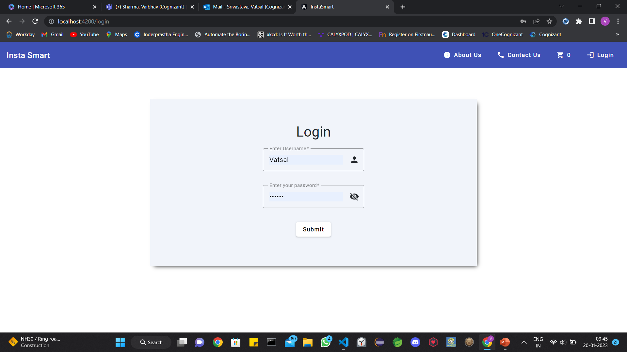
Login

Slide 5
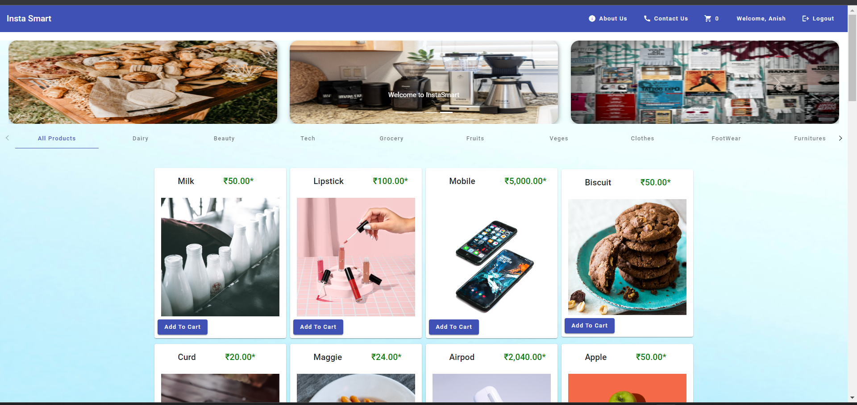
Non Admin Login Interface

Slide 6
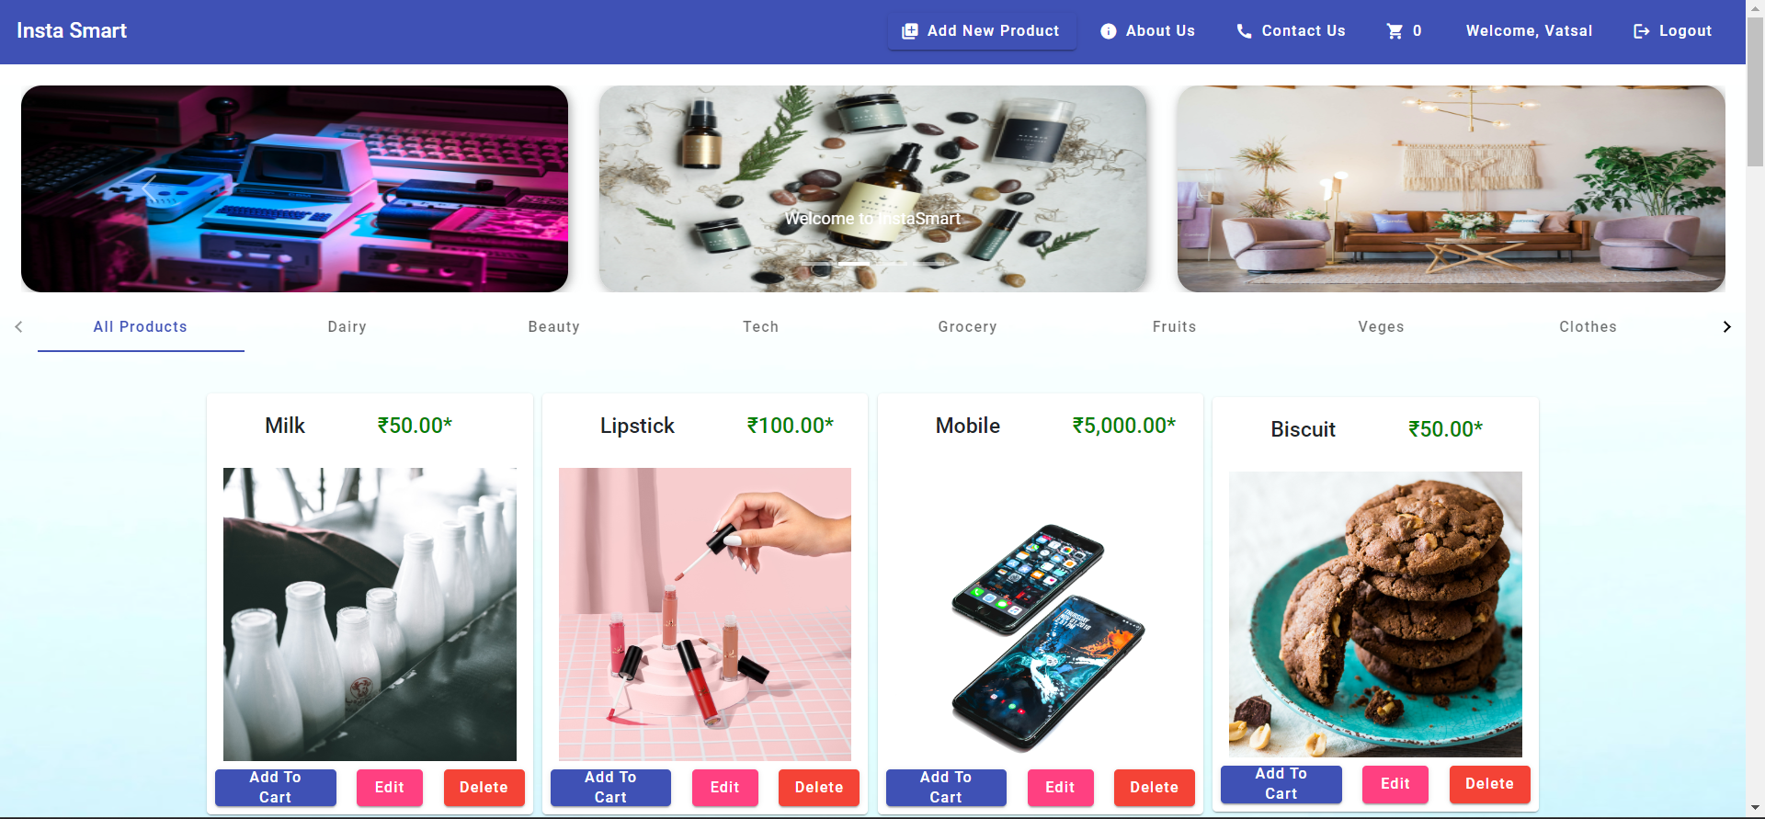
Admin Login Interface

Slide 7
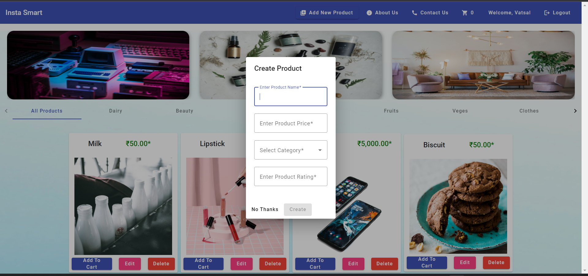
Add new Product

Slide 8
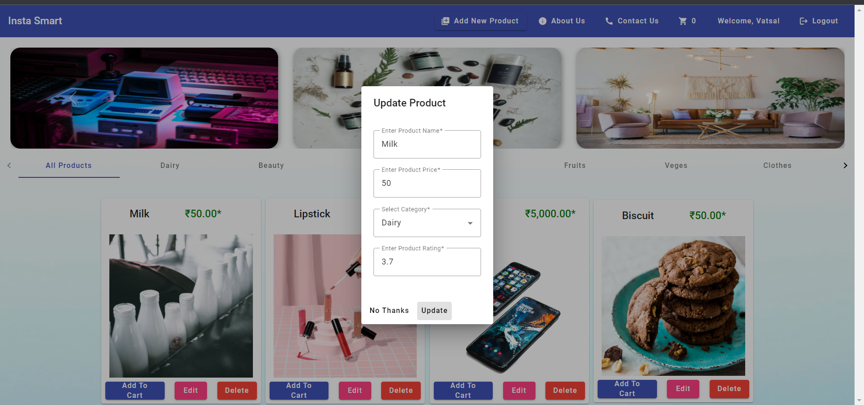
Update Current Product

Slide 9
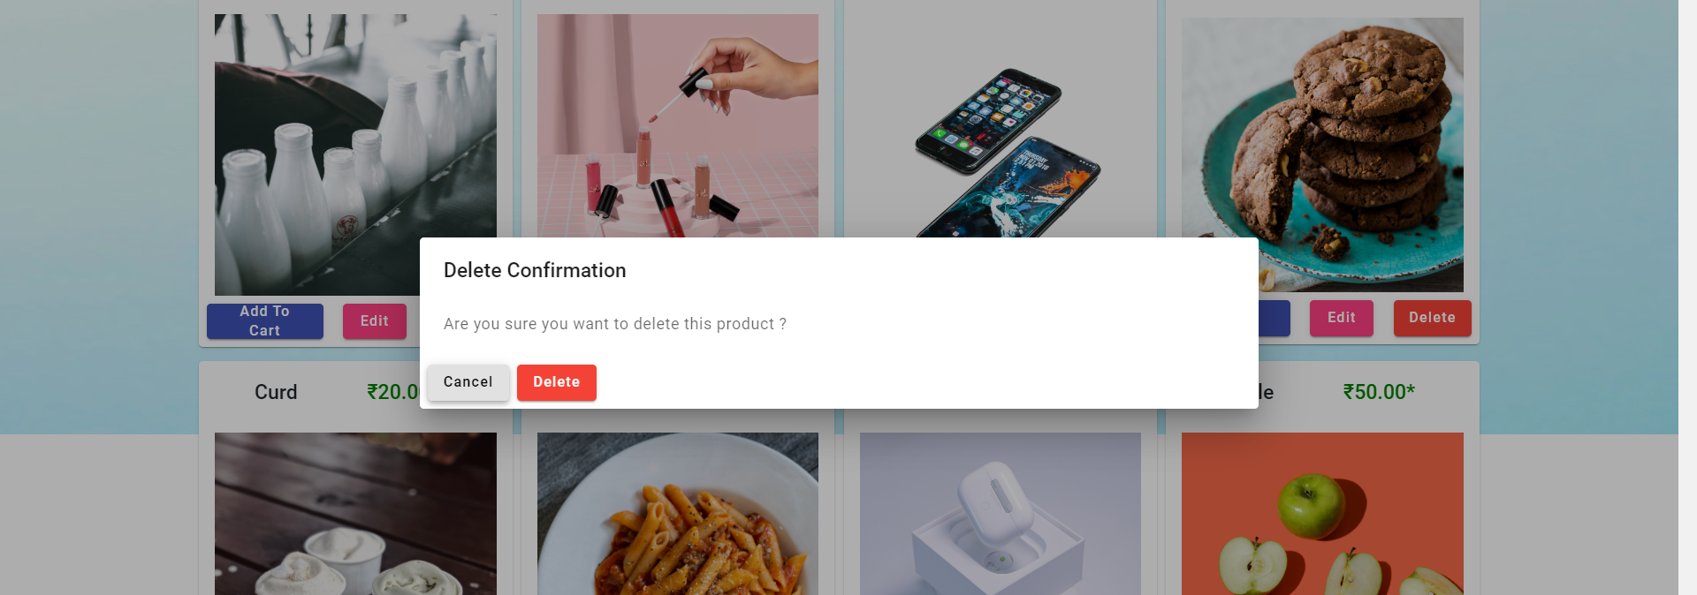
Delete Item Dialog

Slide 10
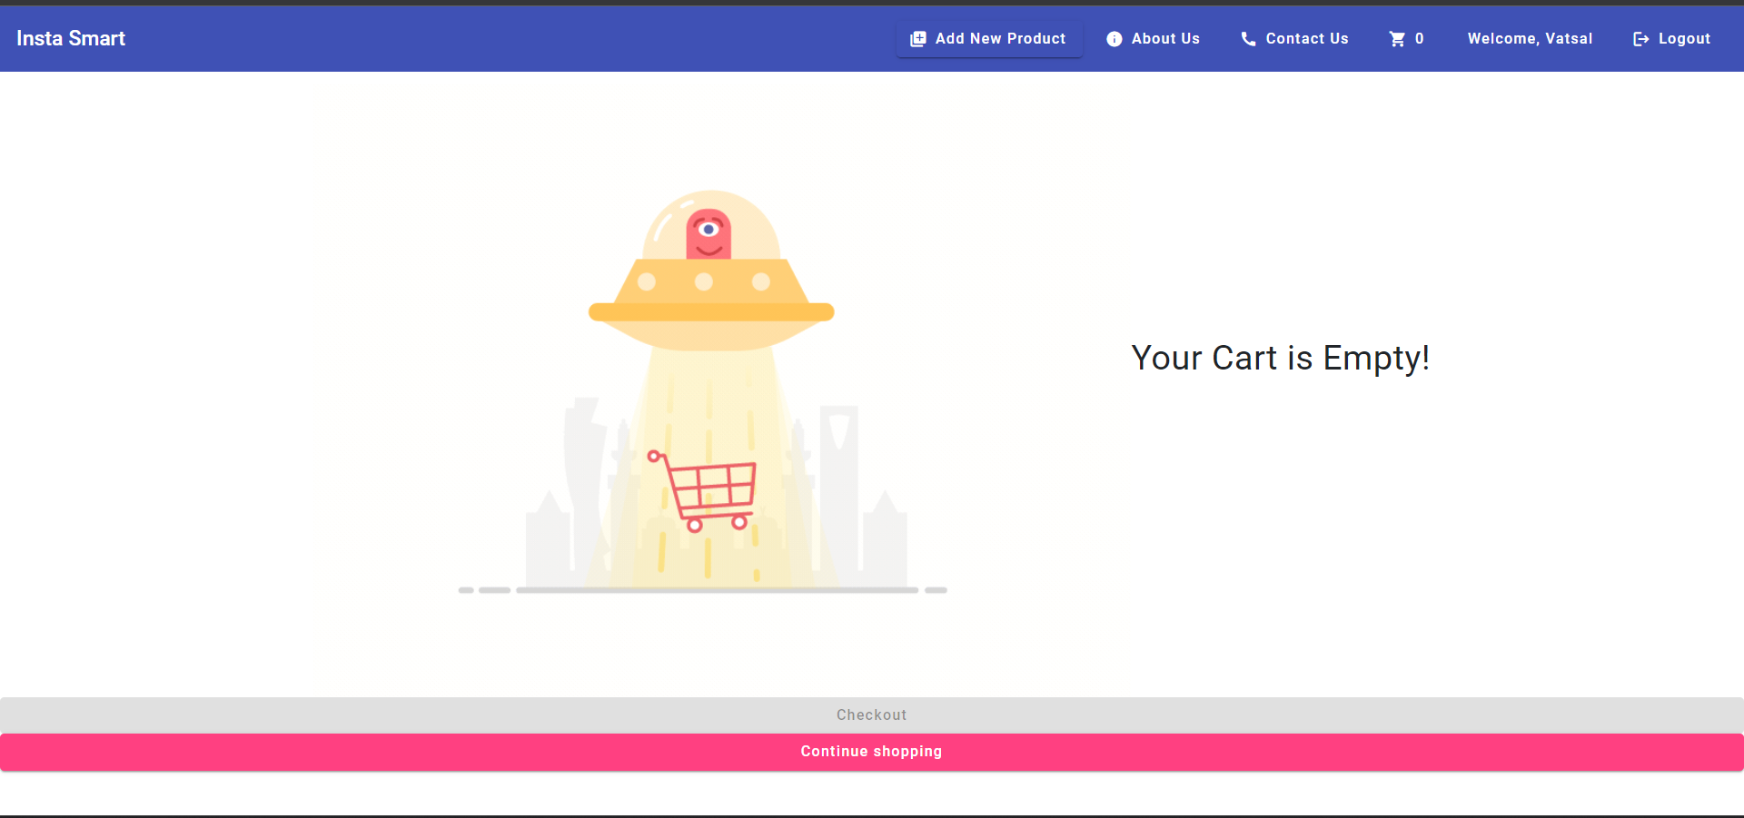
Empty Cart Interface

Slide 11
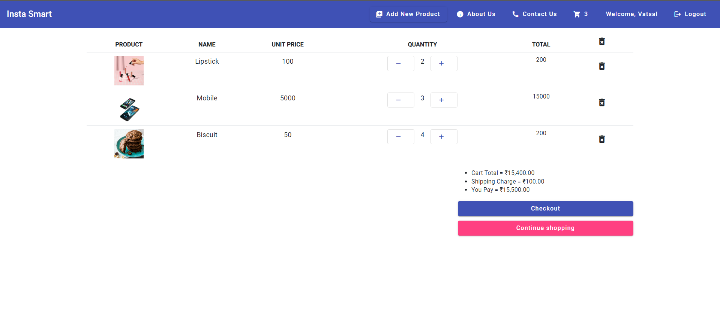
Cart with Items

Slide 12
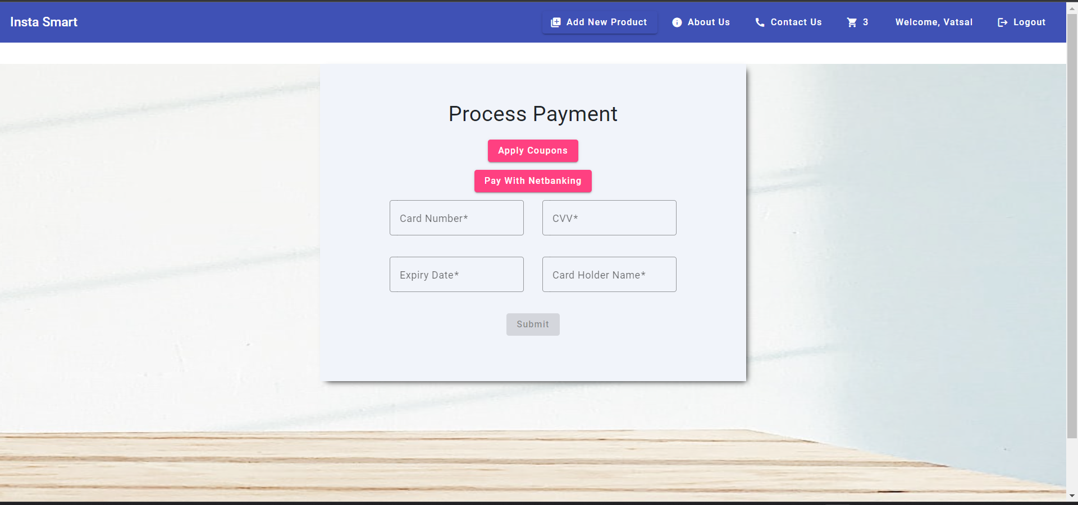
Checkout Page

Slide 13
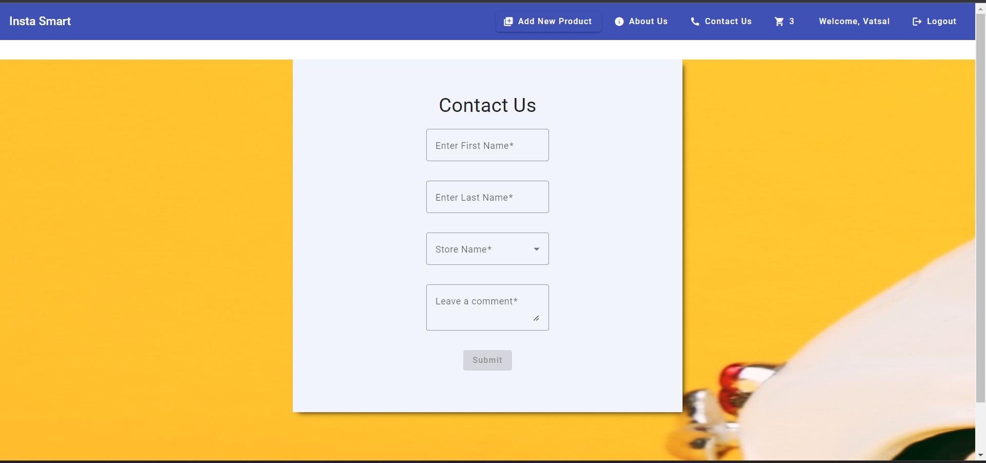
Contact Us Page

